Slide 1

ELECTRICAL RESEARCH AND TESTING ORGANISATION Plot No. 747, Manjusar Village,B/H Gurukrupa Farm,Savli-Vadodara Road, Taluka : Savli, District : Vadodara - 391775 Gujarat, India. E mail ID : lab.head@erto.in/info@erto.in, PHONE NO. : 9099061163 Website : www.erto.in

Slide 2

About Electrical Research and Testing Organisation
ERTO – Was Established in 2013.
In year 2013 Recognised worldwide as one of the Leading testing laboratory for transformer, instrument transformer,cable,insulator & bushing testing.
We got NABL accreditation for testing & calibration.
We got BIS approval laboratory for transformer above 200 kva to upto and including 2500 kva.
ERTO Senior Engineering team of seven has 112 years combined Experience

Slide 3
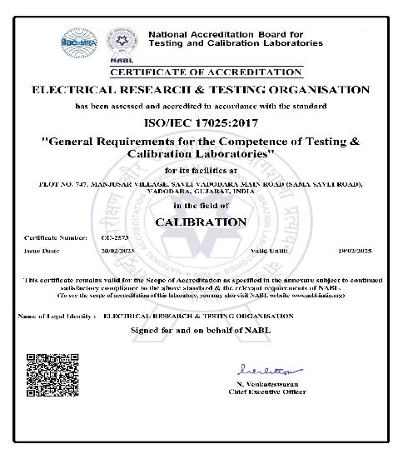
Electrical Research and Testing Organisation Certification
CC-2573 –NABL Accreditation for Calibration

Slide 4
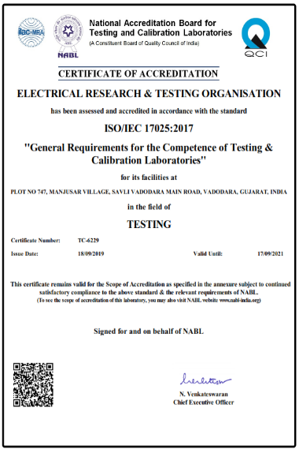
Electrical Research and Testing Organisation Certification
TC-6229 –NABL Accreditation for TESTING

Slide 5
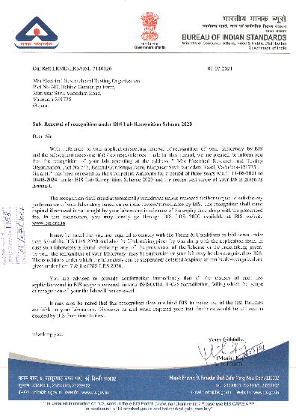
Electrical Research and Testing Organisation Certification
BIS APPROVED TESTING LAB

Slide 6
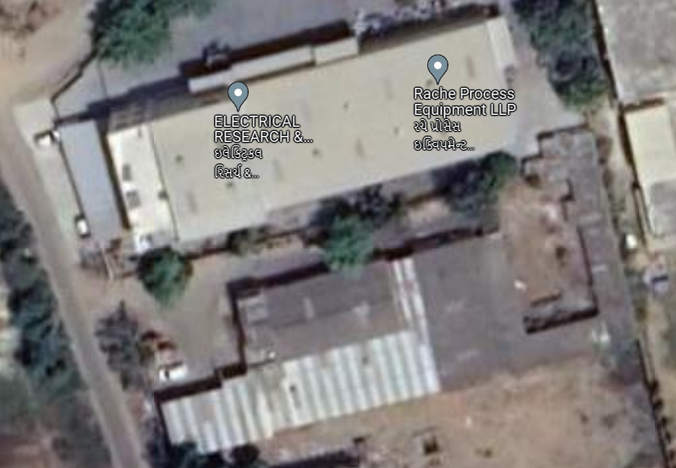
Electrical Research and Testing Organisation
Location well connected to Air , Rail and Road Transportation

Slide 7
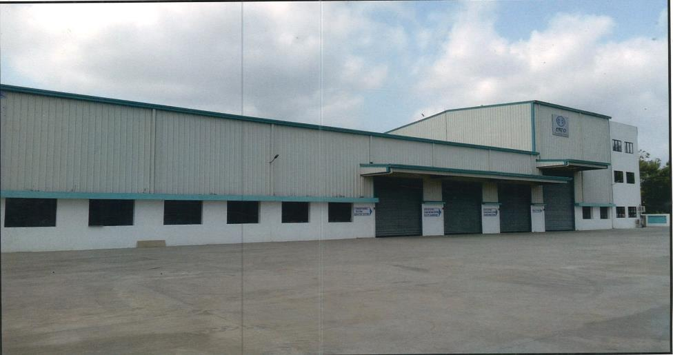
Electrical Research and Testing Organisation Certification
Laboratory Built with Upgraded Technology and Environmental Friendly

Slide 8

Key Employees of the Organization
Technical Director
(Samir Patel)
20+ Yrs. Exp
HR
Strength : 1
10 Yrs. Exp
Purchase
Strength: 1
12 Yrs. Exp
Head of laboratory
(Kinjal Shah)
20+ Yrs. Exp
Testing of transformer.
Strength: 3
25 Yrs. exp
Manager Calibration
Dixit Vasava
11+ Yrs. Exp
Manager transformer testing
Kaushik Patel
15+ Yrs. Exp
Manager instrument transformer testing
Deepak Zala
18+ Yrs. Exp
Testing of instr. Transfo.
Strength: 2
25 Yrs. exp
R&D & Design Head (Samir Patel)
20+ Yrs. Exp
Team Strength : 3
Calibration
Strength:2
12 Yrs. exp
Operators
Strength - 6
Avg Exp- 10 Yrs.
Customer Attention
Strength:2
20 Yrs. exp
Total Industrial Experience of the team is 112 Yrs.

Slide 9
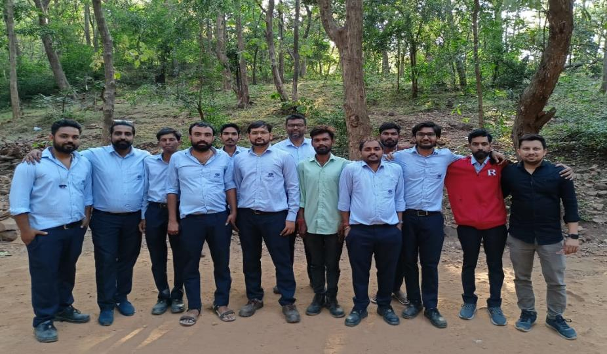
Key Employees of the Organization
TEAM COMITTED FOR CUSTOMER SATISFACTION

Slide 10
Organization Processes
Defined & Re-define
CA & PA For continual Improvement
Implementation
Monitor & Measurement is Continuous
Process are defined and validated

Slide 11
Testing & calibration Standards & Codes
Customer Specification.
IS 2026 (Power Transformer & Dry Transformer)
IS 1180 (Distribution Transformer up to 2500 KVA)
IS 11171 (Dry Transformer)
IEC 60076 (Power & Distribution Transformer)
IEEE C57.159 (Distributed Photovoltaic Power Generation Systems)
IEEE C57.18.10. (Rectifier Transformer)
CBIP – 317
IEC 61378
IS 2099: 2007
IEC 60137: 2017
IEC 62271-1: 2017
IEC 60383-1: 1993
IEC 62155: 2003
IS 1445: 1977
IEC 60168: 1994
IS 2544: 1973
IEC 61109: 2008
IS 731: 1971
IS 2099: 2007
IEC 60137: 2017
IEC 62271-1: 2017
IEC 60168: 1994
IEC 62155: 2003
IEC 60383-1: 1993
IS 1445: 1977
IEC 62217: 2012
IS 2544: 1973
IS 5142: 1969
IEC 61558: 2017
IS 12021: 2015
IEC 60660: 1999
IEC 60099-1: 1991
IEC 60060
100% adherence to customer specification & Standards

Slide 12
CALIBRATION FACILITIES
Inhouse & Onsite Facilities in CALIBRAION

Slide 13
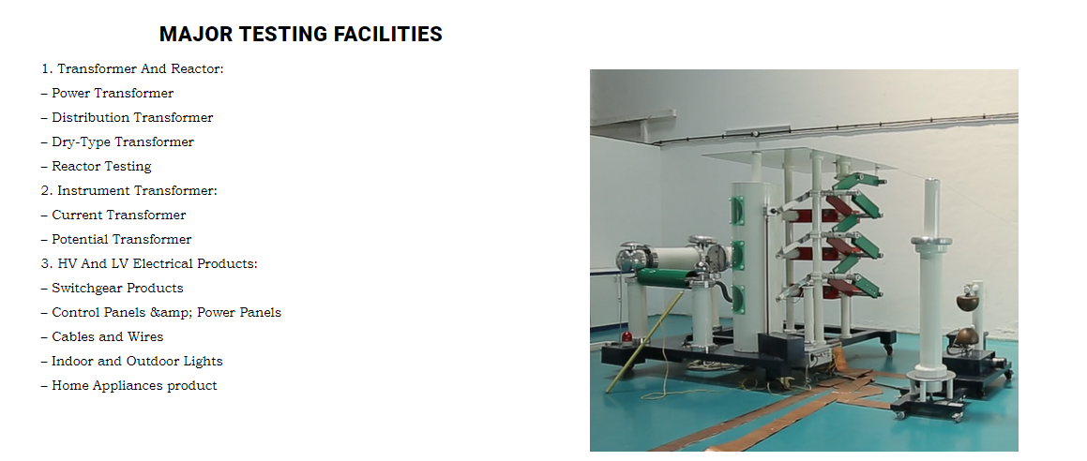
Testing Facilities
Above product can be tested as per IS,IEC CBIP Manual & customer requirement
Test laboratory suitable to measure Partial discharge with ambient <1pc

Slide 14

New facility developed at ERTO with NABL accreditation & Under approval for BIS certification
Short circuit test for distribution transformer up to 200 kVA
Short circuit test for Voltage transformer indoor and outdoor type
short time Current (STC) test for Current transformer indoor and outdoor type .
Inhouse type testing facility for instrument transformer, bushings, insulators, Isolators & High Tension XLPE cable.

Slide 15
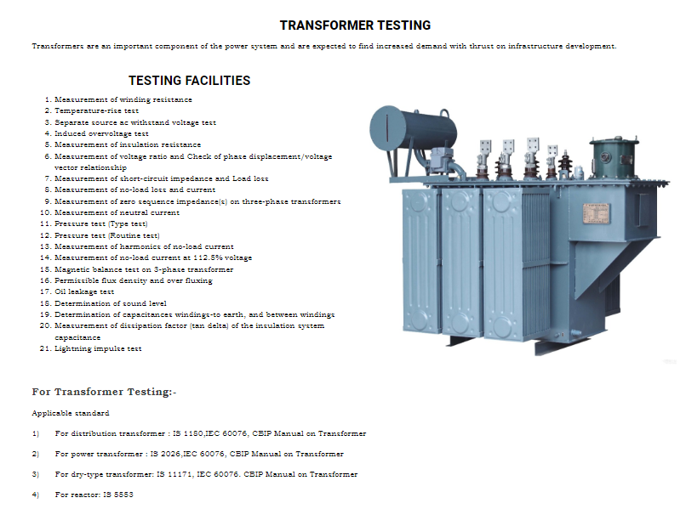
Testing Facilities
Above product can be tested as per IS,IEC,CBIP Manual & customer requirement

Slide 16
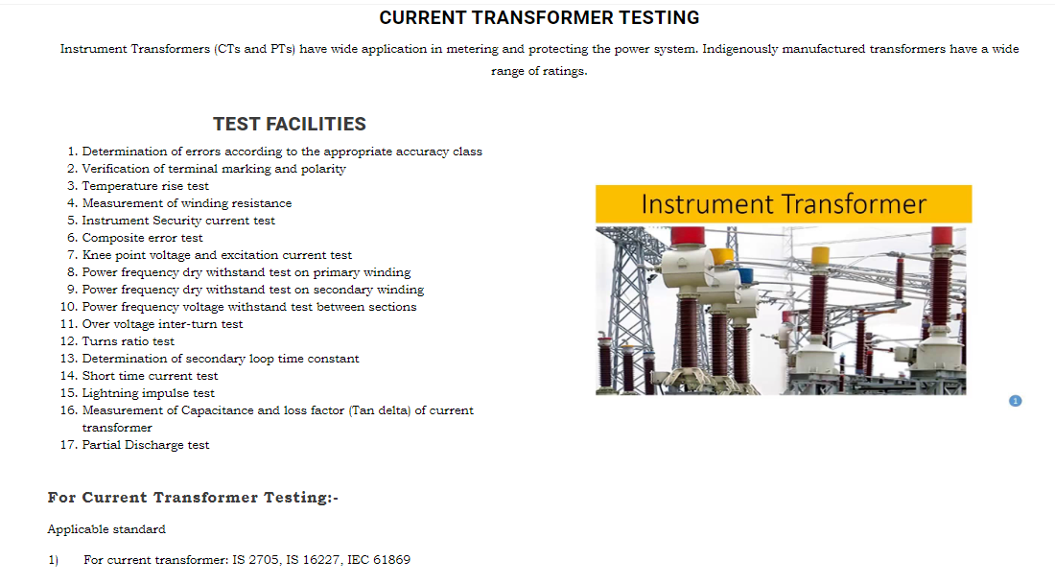
Testing Facilities
Above product can be tested as per IS,IEC & customer requirement

Slide 17
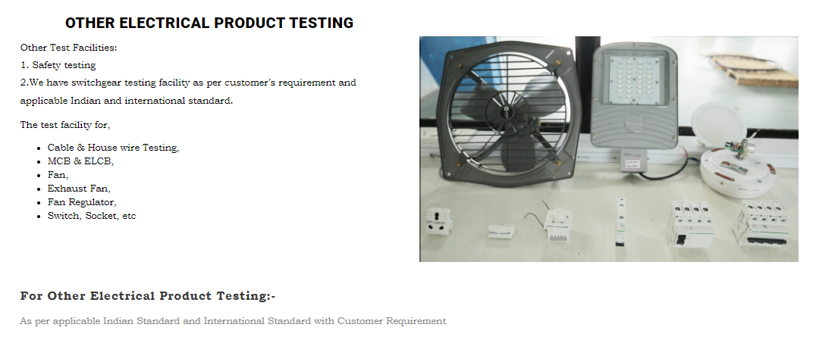
Testing Facilities
Above product can be tested as per IS,IEC & customer requirement

Slide 18
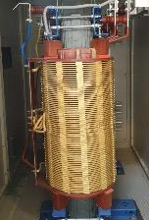
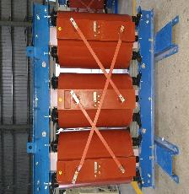
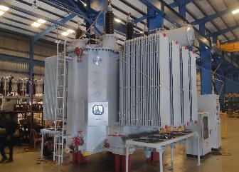
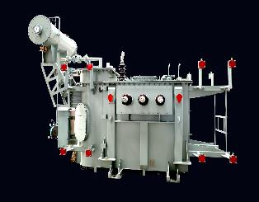
Products which we are tested
DRY TYPE TRANSFORMER
LIQUID FILLED TRANSFORMER
Mineral Oil Filled
Silicon Oil Filled
Natural Ester Oil Filled
Synthetic Ester Oil Filled
Vacuum Pressure Impregnated
Cast Resin
Our inhouse testing Range for all routine, type & special test - Dry type :5 KVA to 5000 KVA 33 KV Class
Liquid type : 5 KVA to 5000 KVA 33 KV Class

Slide 19
Products which we are tested
DRY TYPE TRANSFORMER
LIQUID FILLED TRANSFORMER
Mineral Oil Filled
Silicon Oil Filled
Natural Ester Oil Filled
Synthetic Ester Oil Filled
Vacuum Pressure Impregnated
Cast Resin
Our on site testing Range for all routine, type & special test - Dry type :5 KVA to 160 MVA 220 KV Class
Liquid type : 5 KVA to 160 MVA 220 KV Class

Slide 20
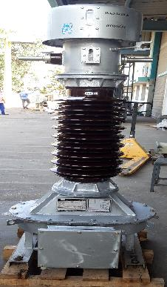
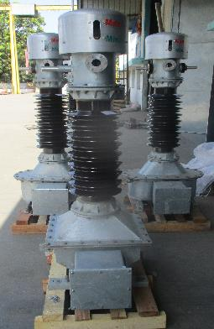
Products which we are tested
Current Transformer
Protentional Transformer
Our on inhouse testing Range for all routine, type & special test - Current transformer Range 1 A to 20000 A, Voltage Class:660 V to 440 kV
Protentional transformer : Potential Transformer Range : 63.5 V to 220 kV/v3

Slide 21
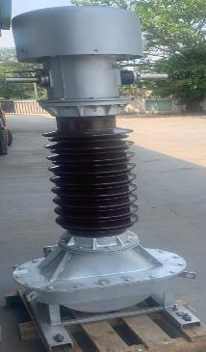
Products which we are tested
Current Transformer
Protentional Transformer
Our on site testing Range for all routine, type & special test - - Current transformer Range 1 A to 20000 A, Voltage Class:660 V to 440 kV
Protentional transformer : Potential Transformer Range : 63.5 V to 220 kV/v3

Slide 22
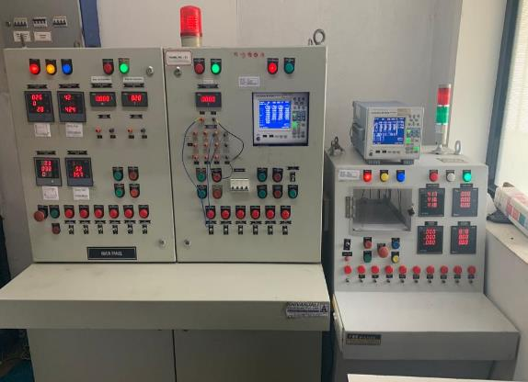
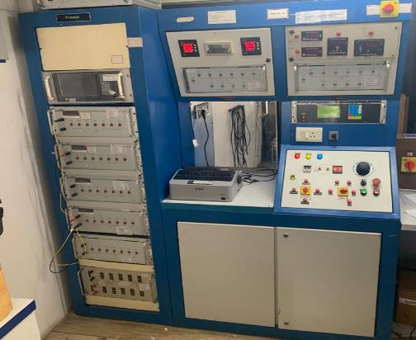
Testing Facilities for transformer, cable insulator,bushing,current transformer, potential transformer
All measuring meters calibration traceable to Accredited labs and 0.1 class Accuracy

Slide 23
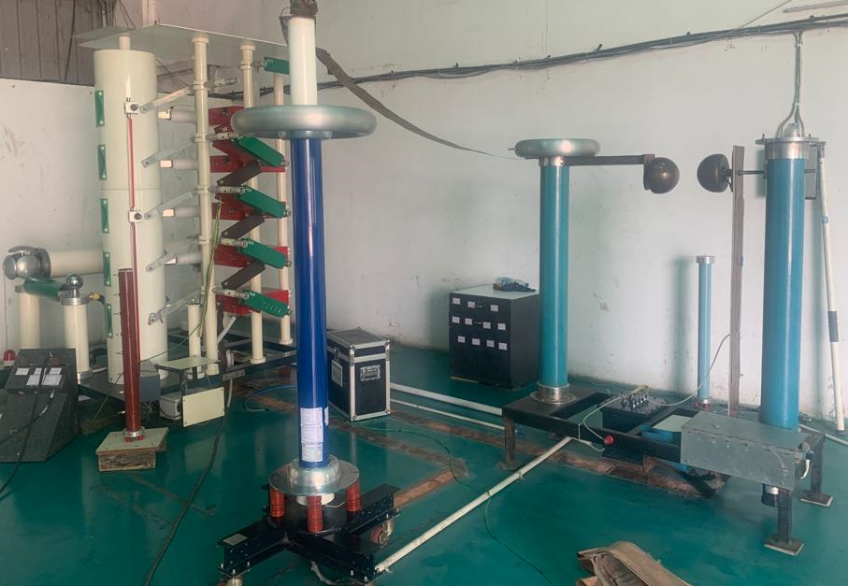
Impulse testing Facilities for transformer, cable insulator,bushing,current transformer, potential transformer
We have impulse test facility up to 500 kvp.

Slide 24
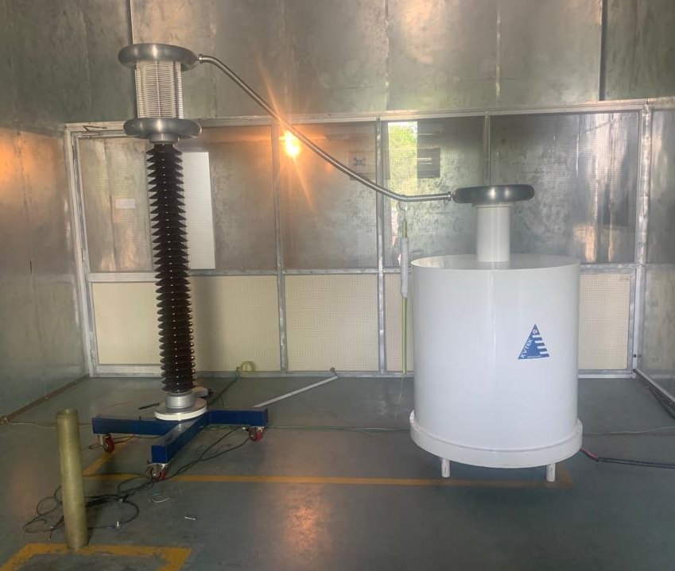
Partial measurement testing Facilities for cable insulator,bushing,current transformer, potential transformer
We have Partial measurement testing Facilities up to 160 kv
With less than ambient 1 pC calibration rang 2 pc to 5000 pc

Slide 25
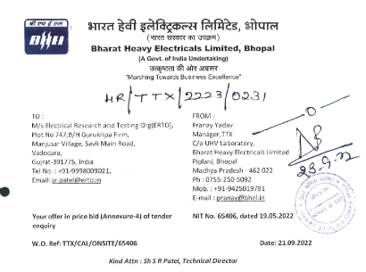
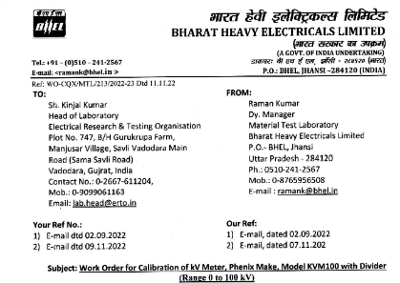
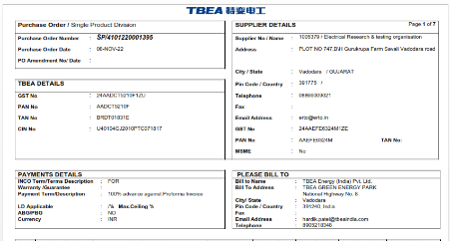
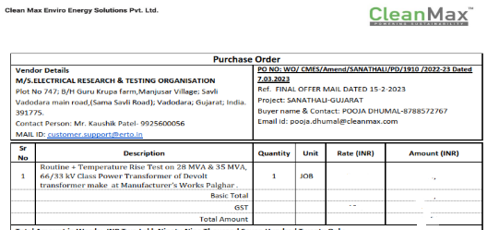
Direct Order
Performance evaluated against PO witnessed by with satisfactory result

Slide 26
List of our Valued customer

Slide 27
Executed Orders
1000+ Transformers,Instrument transformer,bushing,cable & insulator are tested Satisfactorily in the field & in house since -2013

